Slide 1
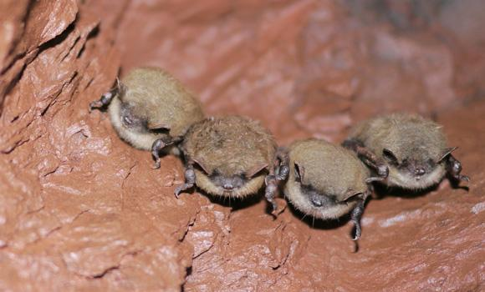

Bat Echolocation Detection
Bety Rostandy (brostandy)
Hadi Soufi (HadiSoufi)
Kevin Keomalaythong (kkeomalaythong)
Thien Le (InsertGithubUsernameHere)
Yang Peng (yangp18)
CSC 505 | 11.30.2018
Final Report
Notes:
everyone

Slide 2
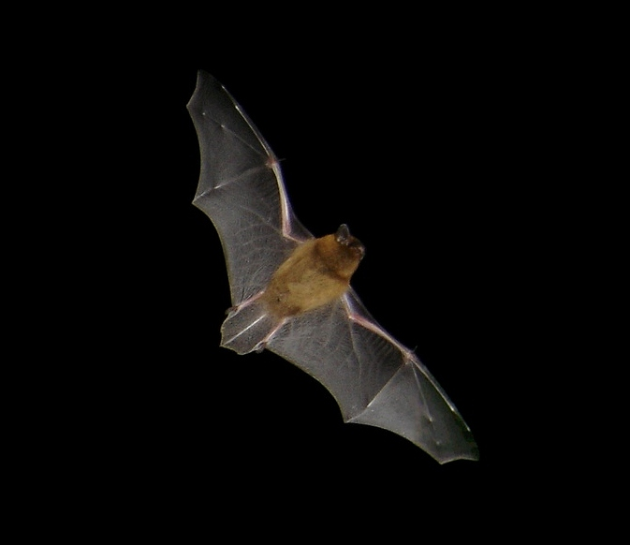
Overview
This project aims to identify and classify bat calls for use in future scientific research.
These bat calls are recorded from over 100 sites across NC, including the UNCG wetlands. This generates hundreds of thousands of recordings.
Notes:
Hadi

Slide 3
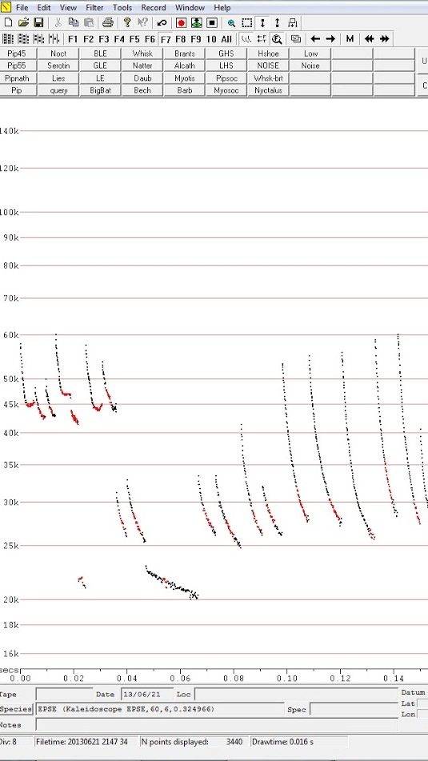
THE DATA
We will be working with bat calls stored in Zero-Crossing form. In ZC form, the dominant frequency sweep of a pulse is easily visible.
Challenges
Noise removal
Signal extraction
Signal analysis
Notes:
Kevin
Normal calls go down, abnormal calls go up and/or straight
Horizontal axis is time, vertical axis is frequency
Calls don’t happen for more than a few (milli)seconds
Some calls have been labeled w/ species names
We just want the sweeps and not the scatter dots around them
Also we want to understand why sweeps are where they are and what we can do with them

Slide 4
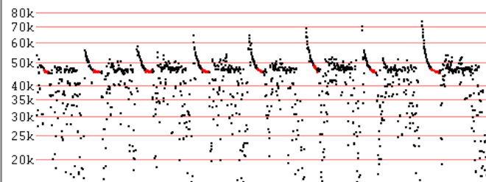
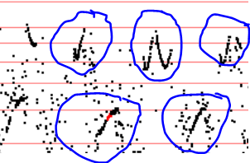
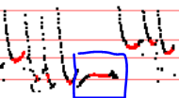
ABNORMAL vs NORMAL CALLS
While most bat calls are used for echolocation, some are not. We aim to identify these so called abnormal calls automatically.
Notes:
Yang

Slide 5
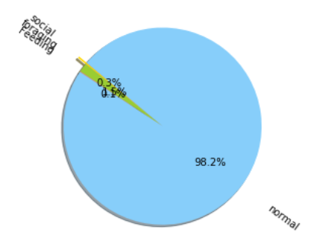
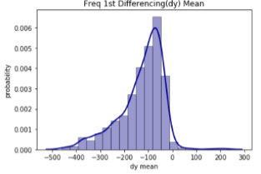
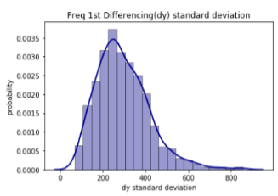
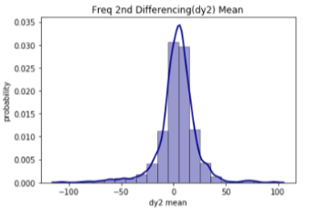
STATISTICS ANALYSIS RESULT
Notes:
Yang
98% of the sample data files were labeled as only containing normal calls and
2% as containing a mixture of normal and abnormal calls.
This founding of signal characteristics inspires the
clustering and classification techniques that we are going to introduce later.
Bat calls identification was done manually by bat researchers; this qualita-
tive method can be time consuming and lead to human-bias
Usually, one audio recording of bat
calls contains many sequential navigation calls, which we regard as normal
calls. Sometimes there are some social calls, foraging calls or feeding calls
mixed in. We are more interested in these abnormal calls than normal calls
as they can tell us a lot more about bat behavior.
The normal bat calls have a regular decreasing trend with a slightly smoothing concave up curvature, while abnormal calls have irregular shape such as upward trend, flat trend, U-shape, W-shape and so on. The x-values in the dataset refer to time in \textit{seconds} and the y-values refer bat call frequency in \textit{Hertz}.

Slide 6
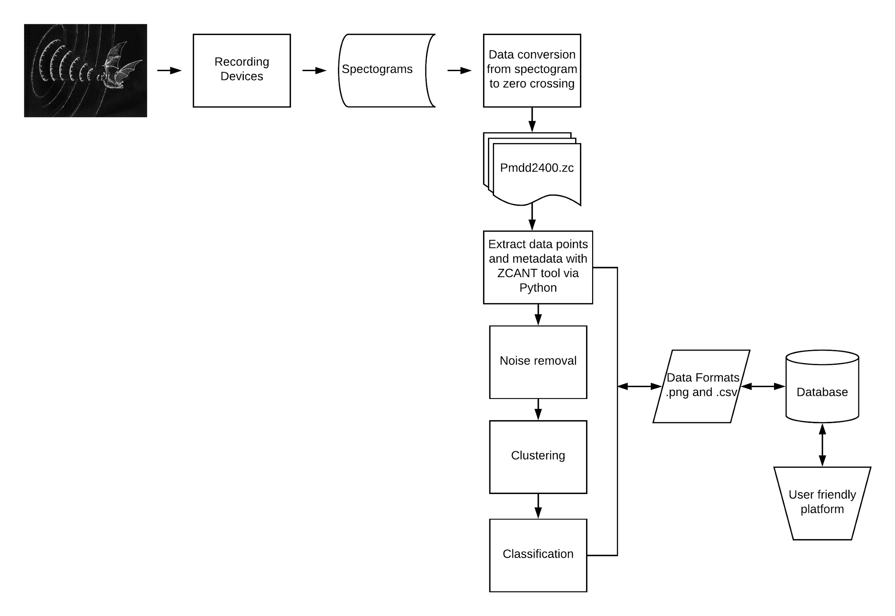
Bat Echolocation Workflow
Notes:
Bety

Slide 7
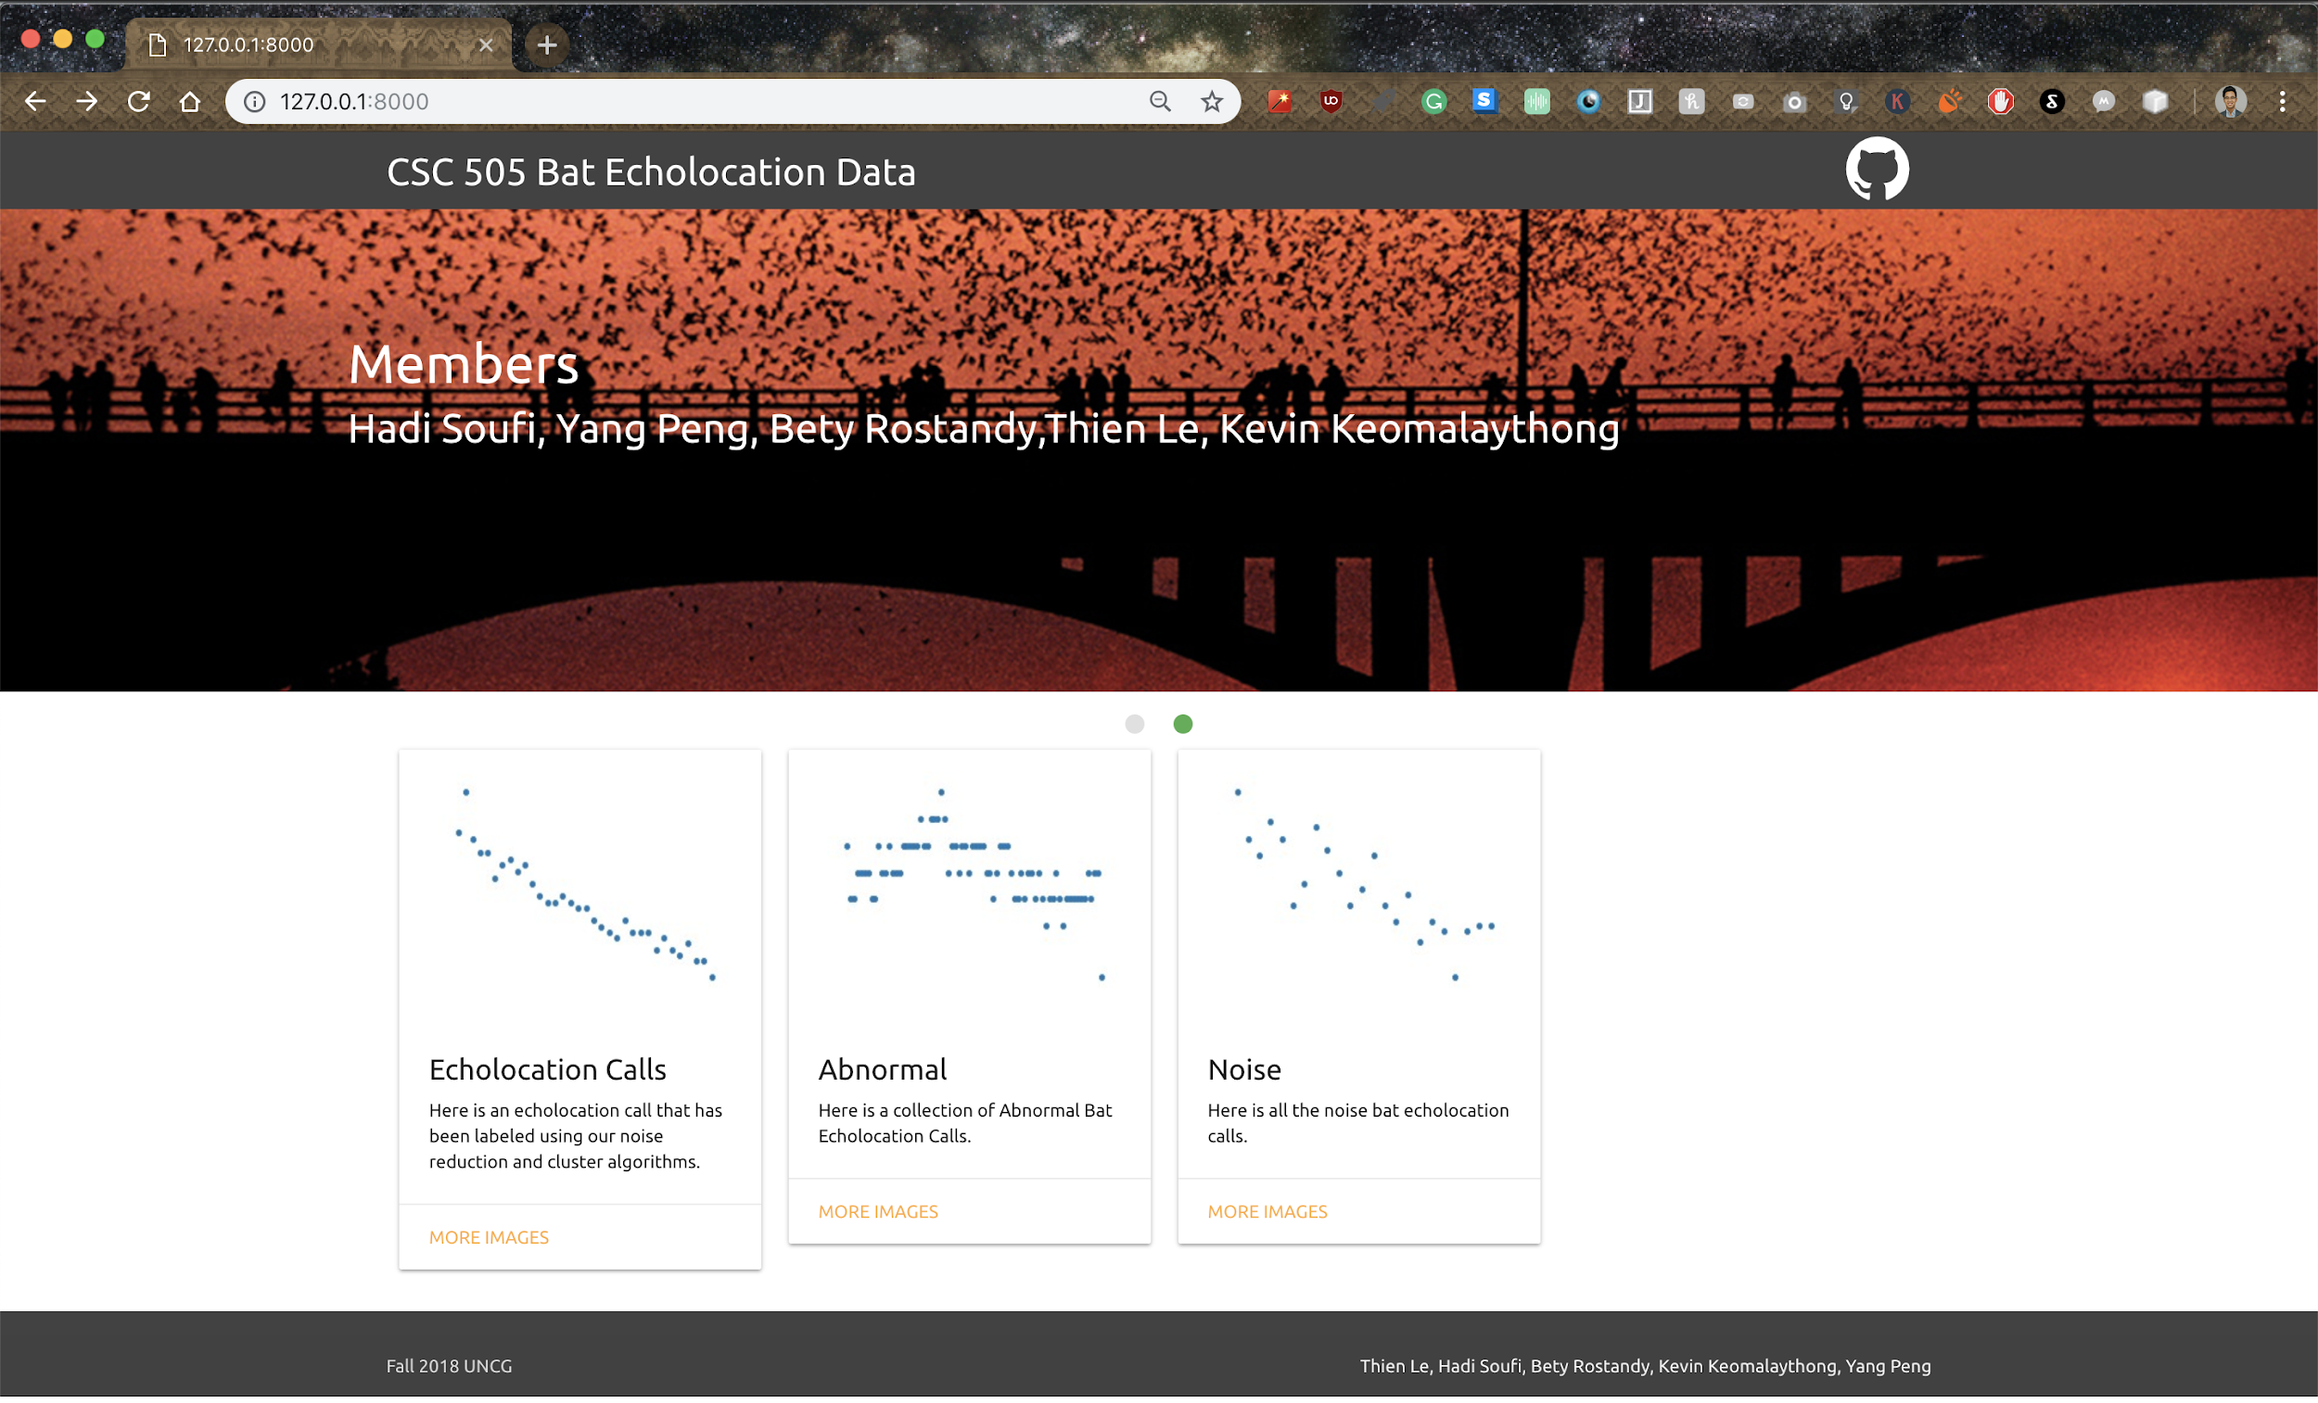
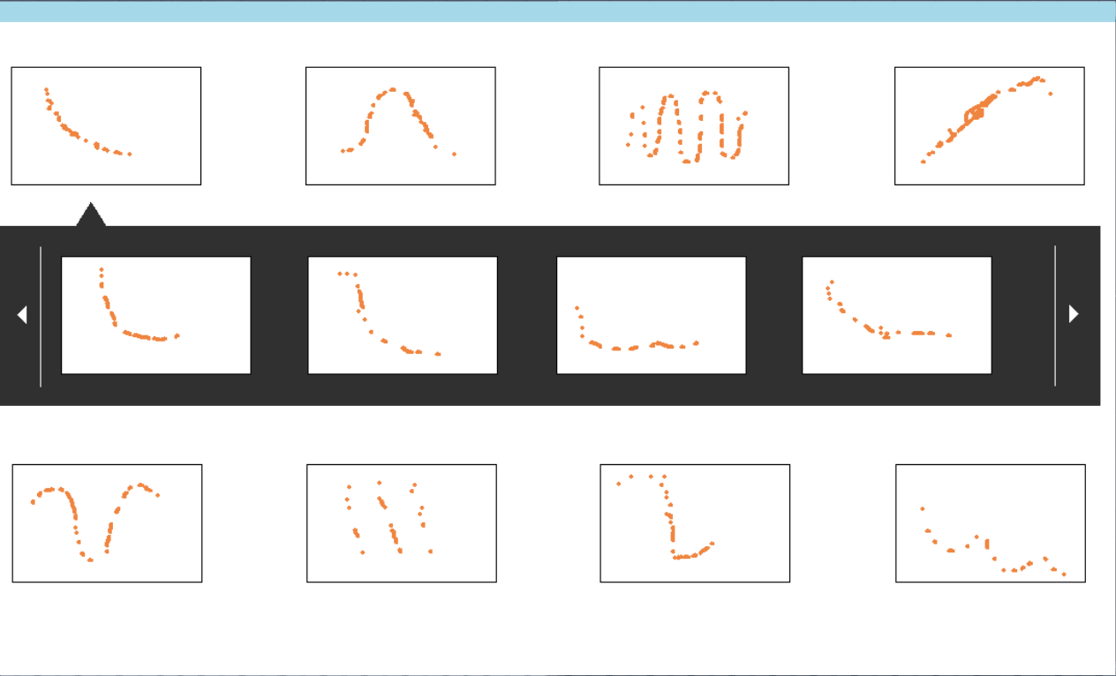
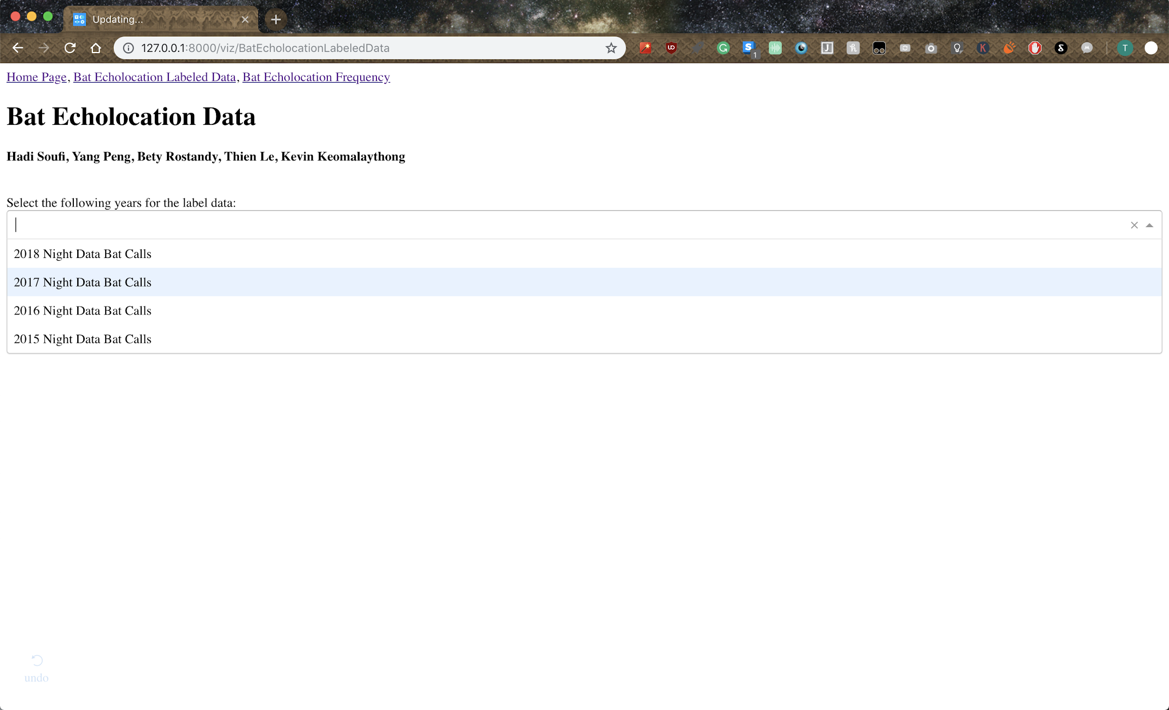
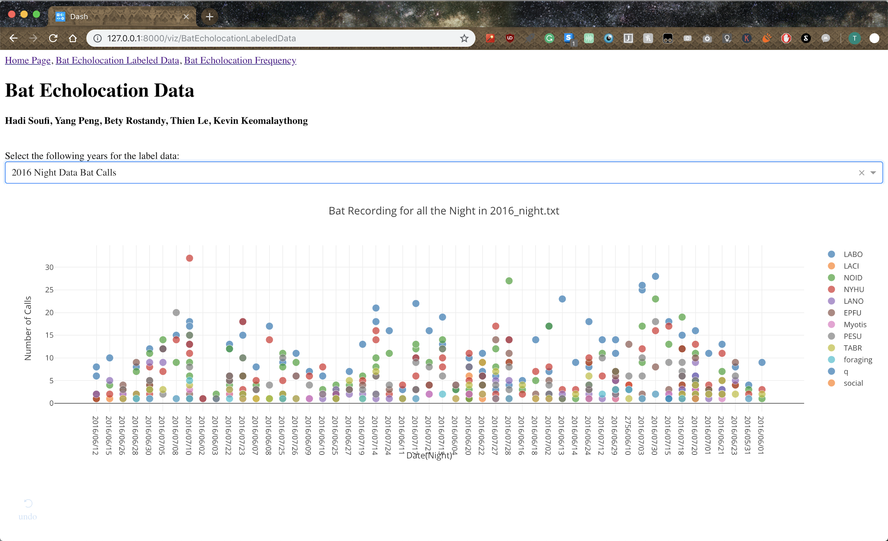
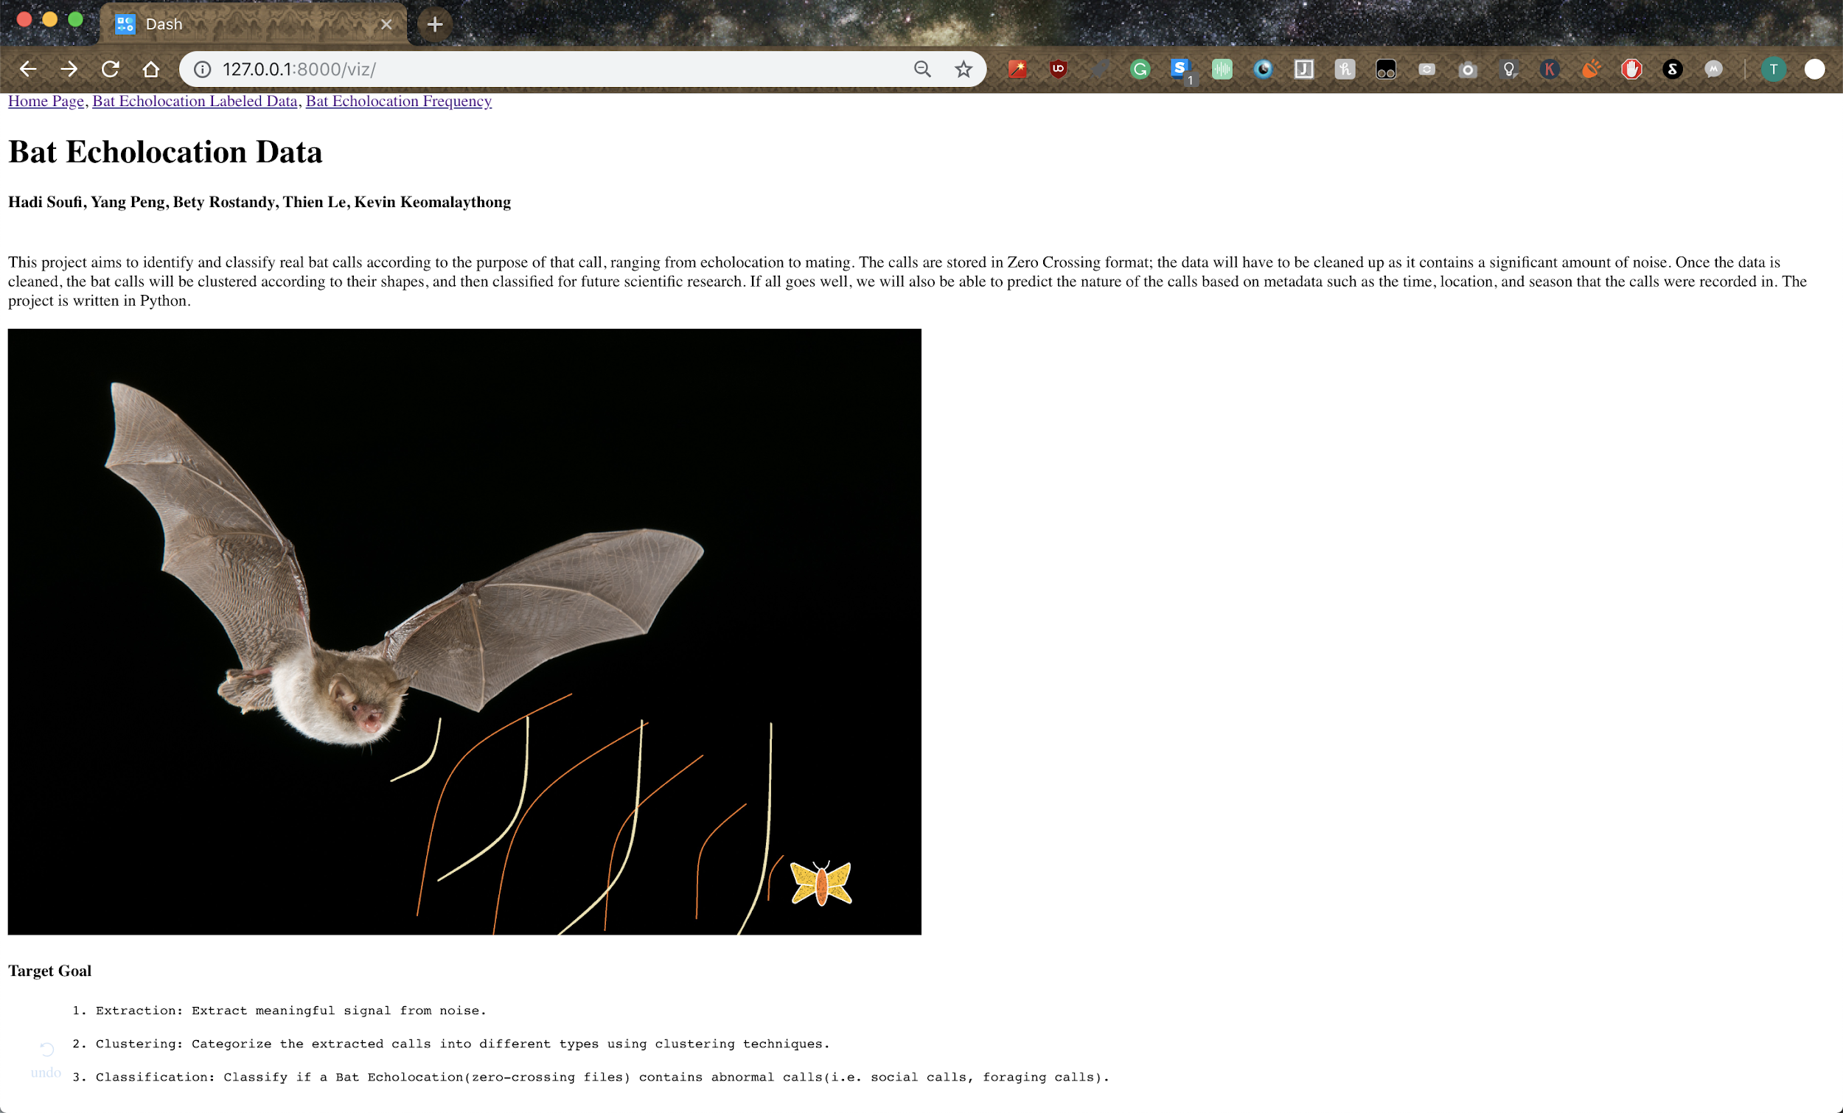
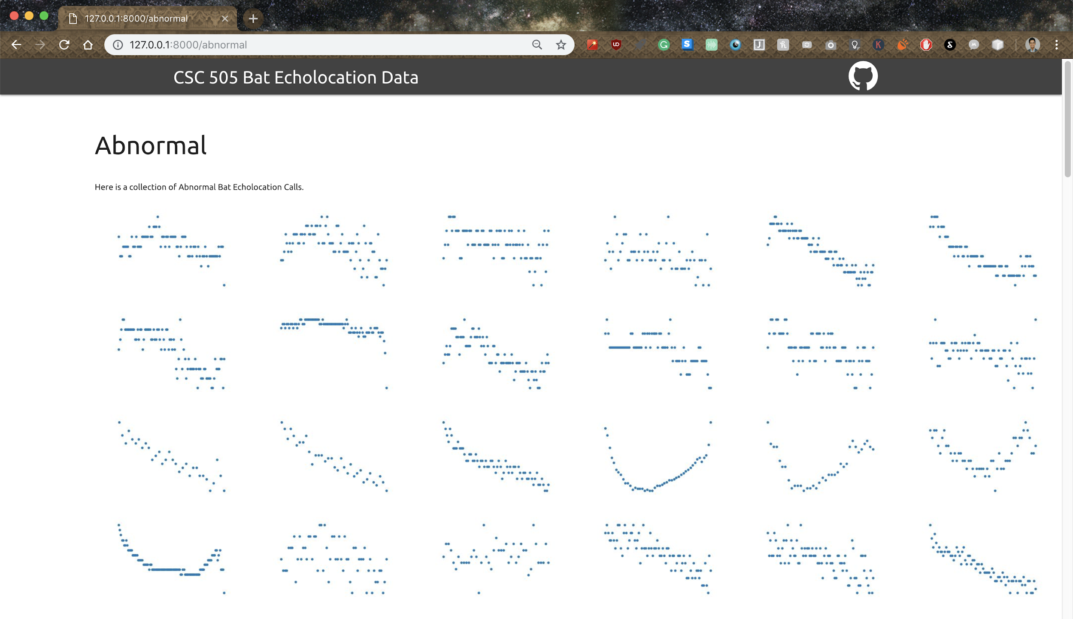
Thien: Django GUI
http://127.0.0.1:8000/

Slide 8
Thien: Wishlist
Make the website into a live production.
Dynamically break up the images into smaller pages.
Make the data points interactive.

Slide 9
Kevin: Completed Tasks
Created a database server to store our data
Created a Python/SQL module to allow GUI-database communication

Slide 10
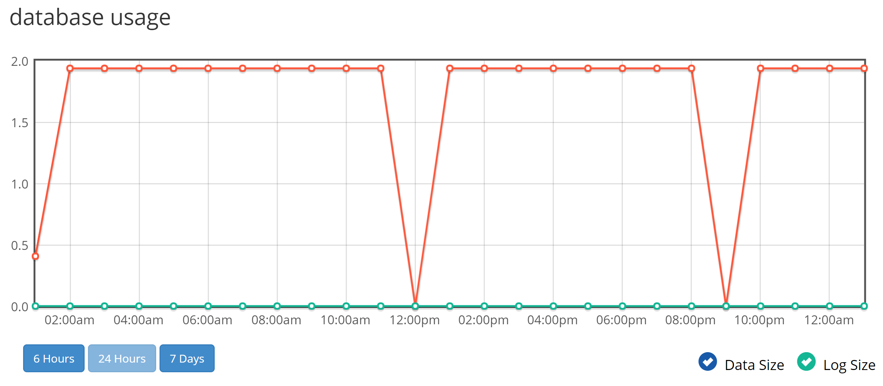
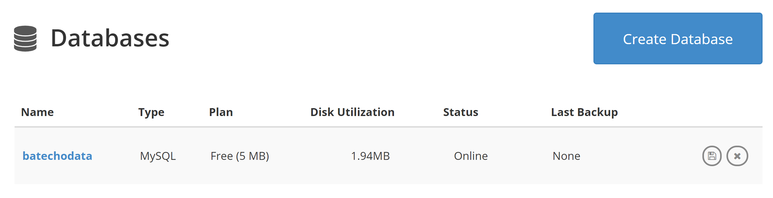
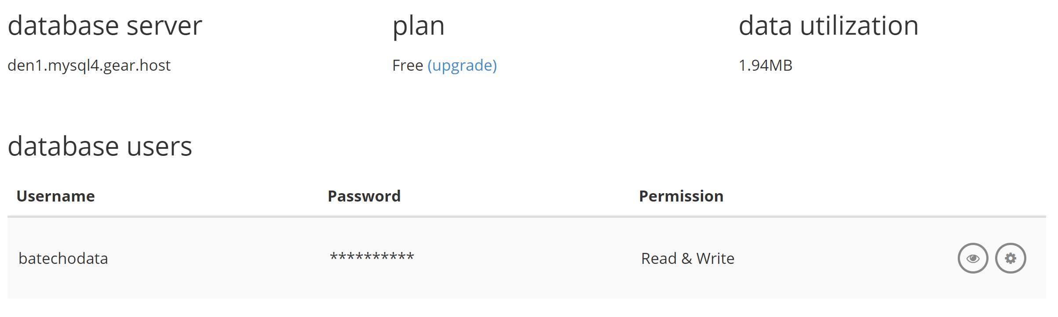
Kevin: Database Cloud Server
GearHost server
Limited storage - 5 MB
Notes:
Recall previous presentation: DB server was only set up for test purposes, full-scale implementation will proceed later on

Slide 11
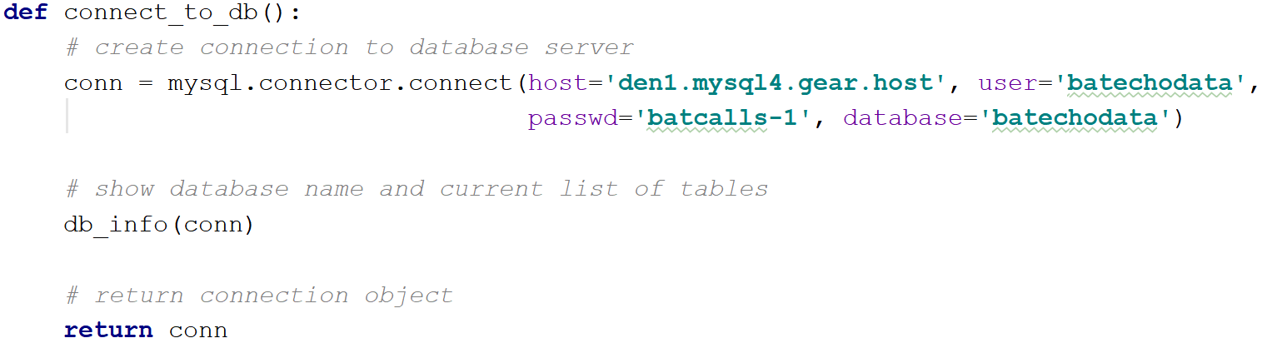
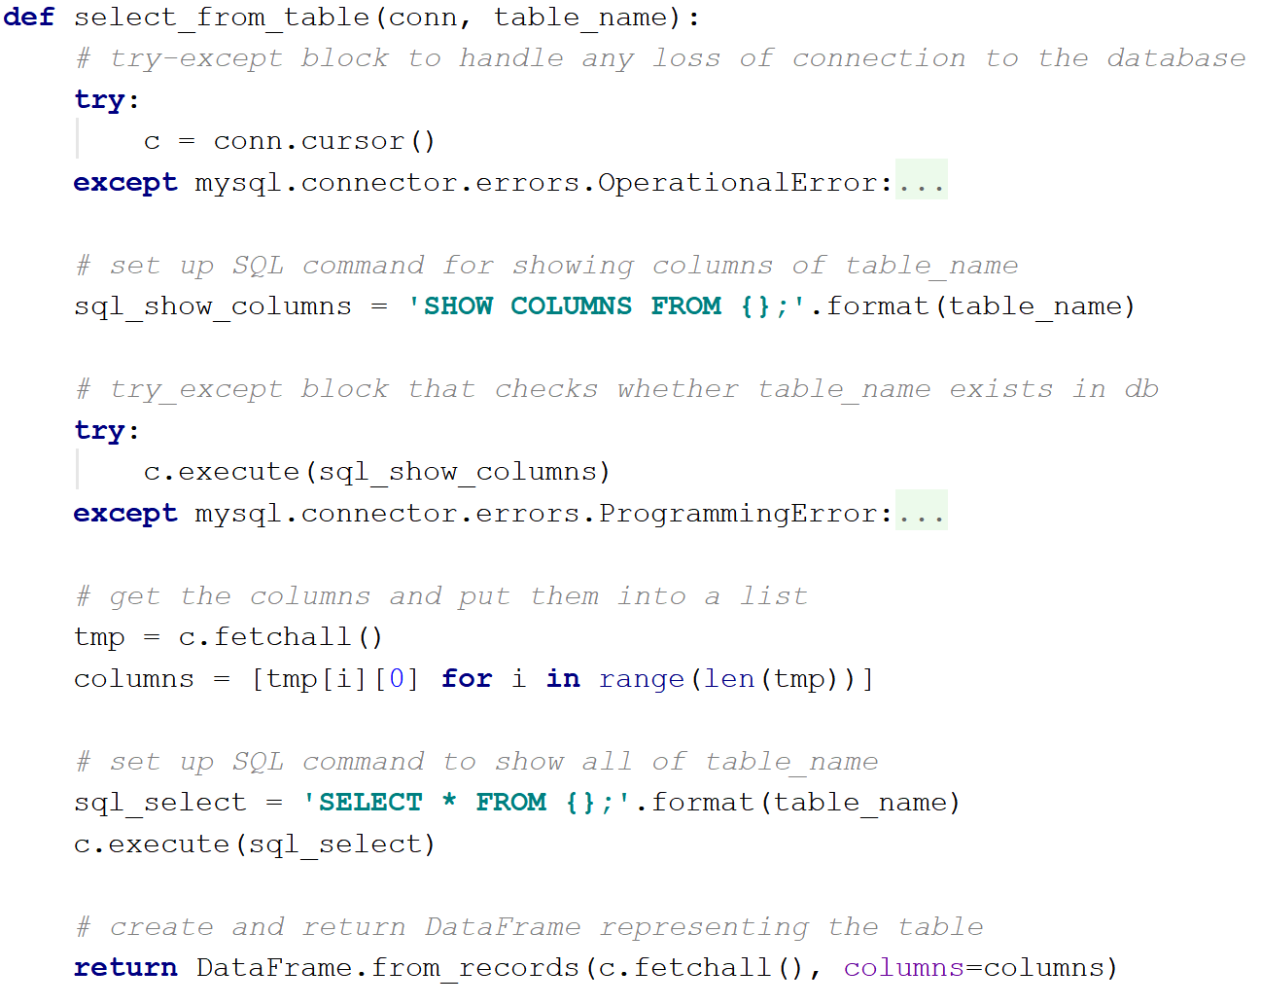
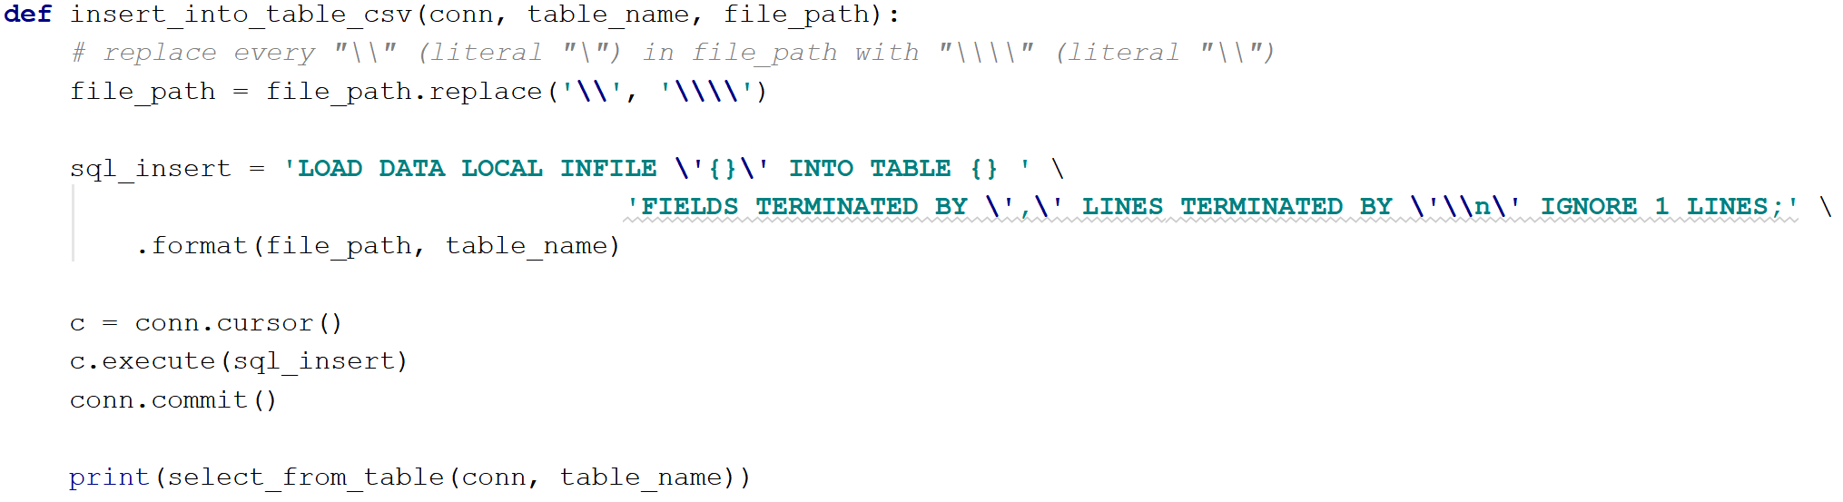
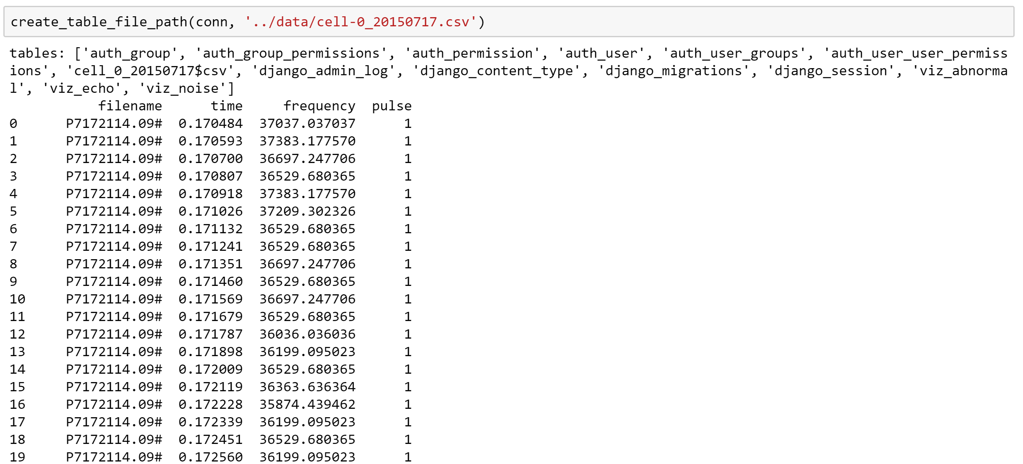
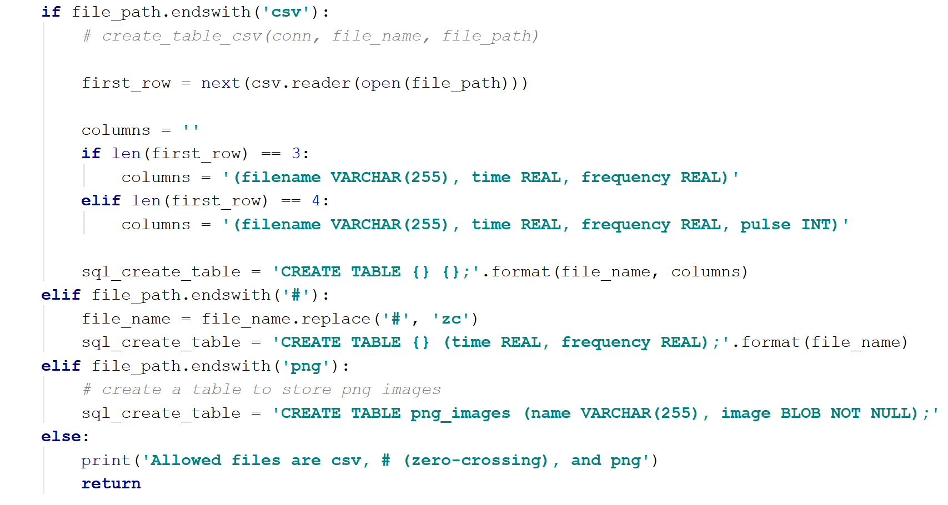
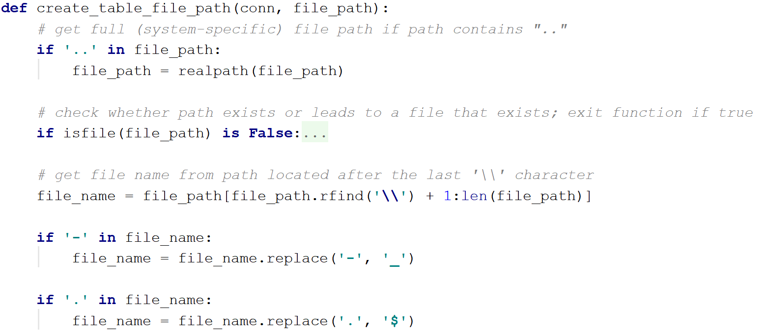
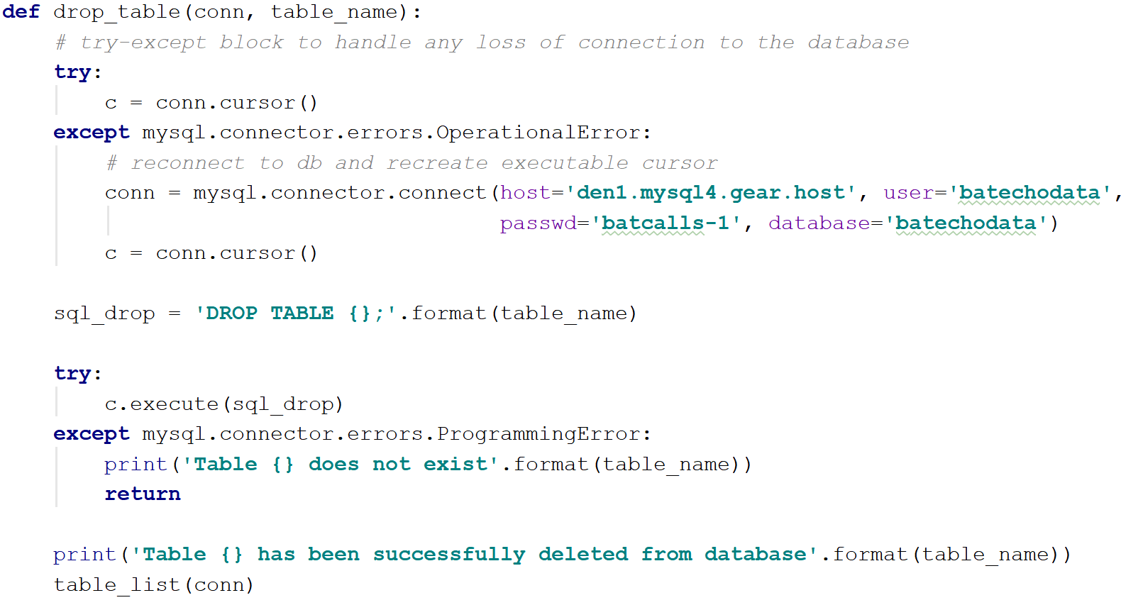
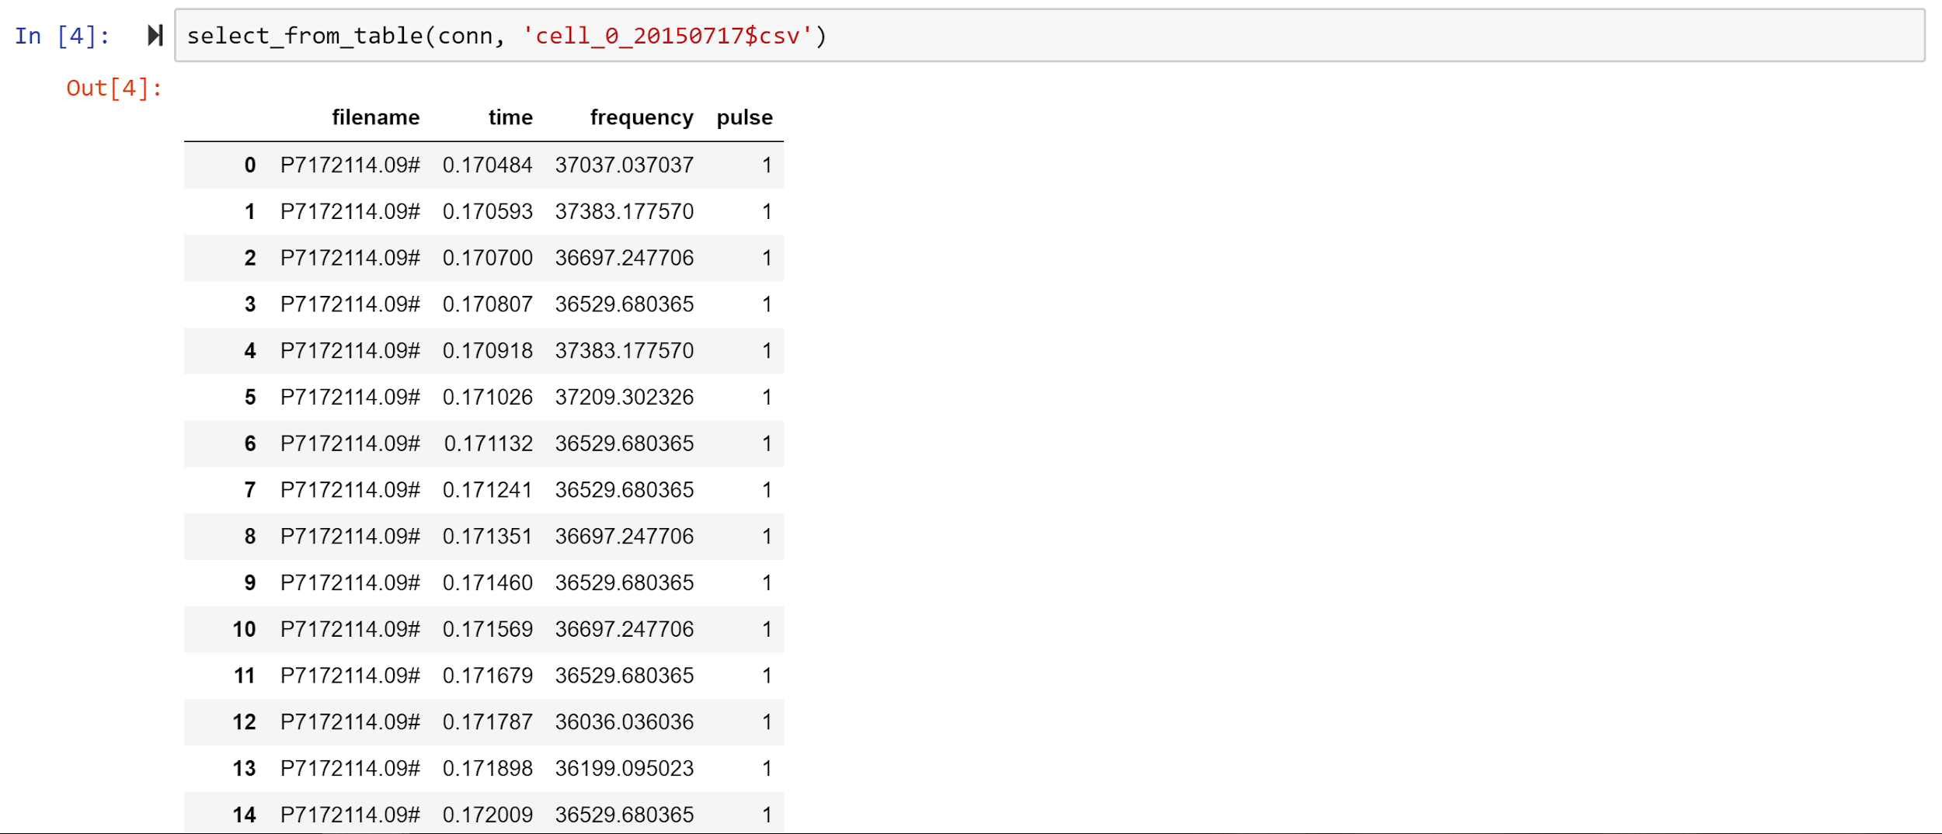
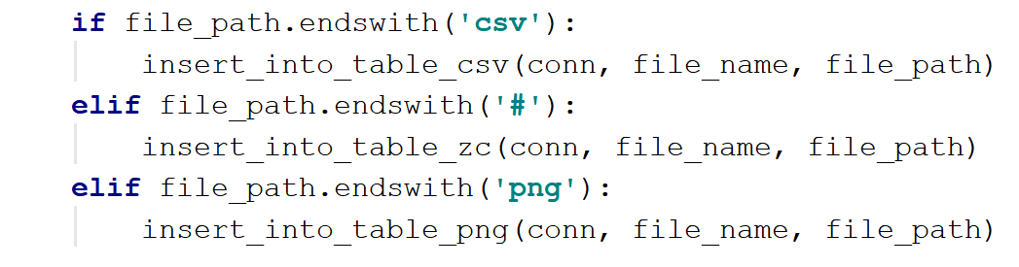
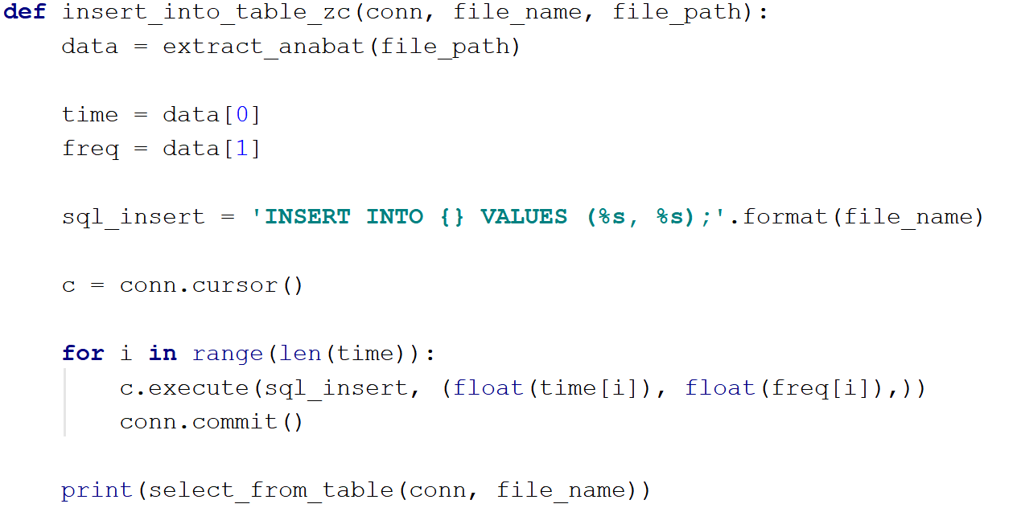
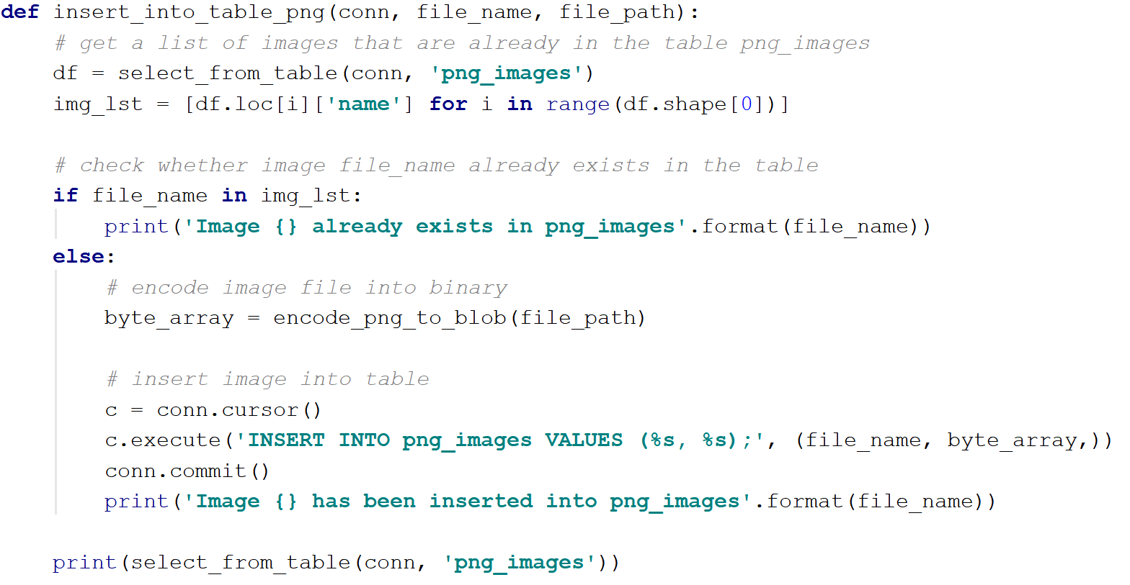
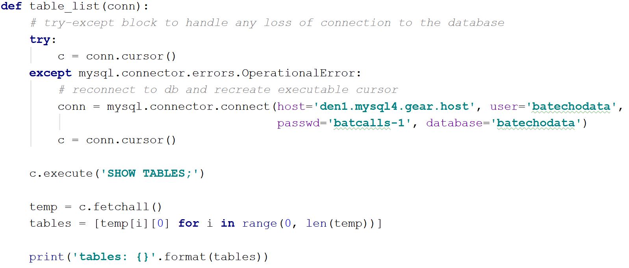
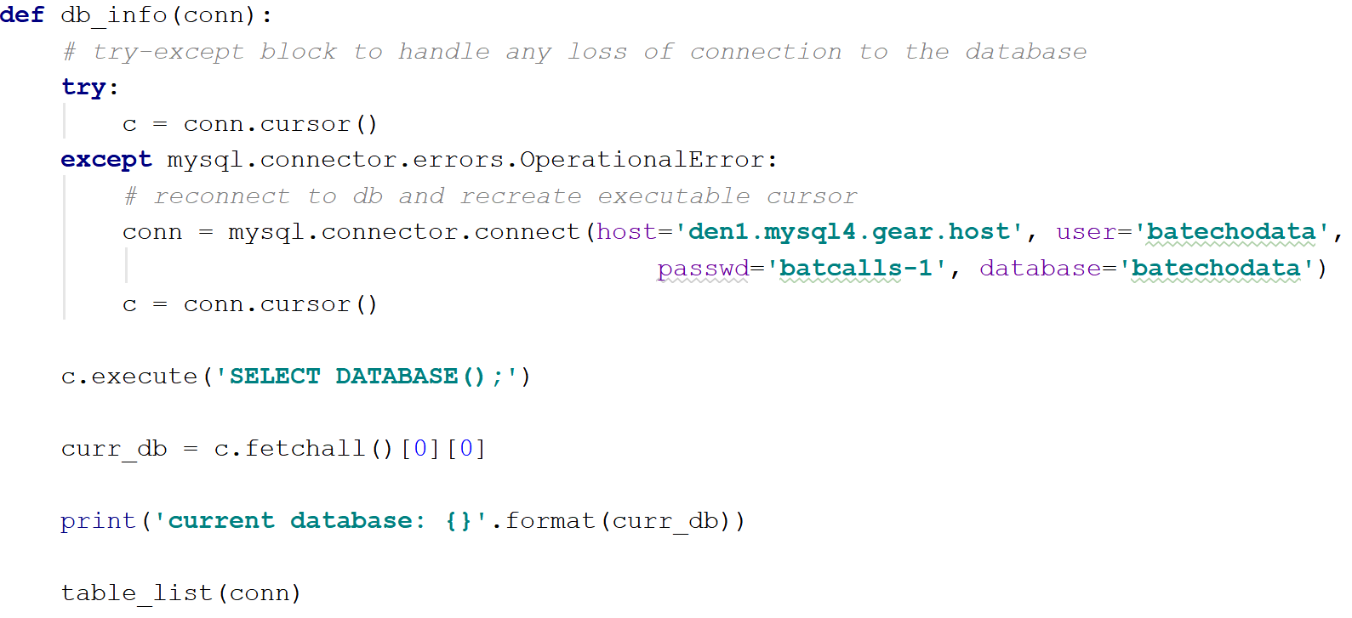
Kevin: Python/SQL Implementation
Connection to database
Example execution
Inserting data from files (CSV, PNG, ZC)
Table selection and deletion

Slide 12
Kevin: Wishlist
Implemented linear regression for classification (and possibly statistics)

Slide 13
Hadi: Completed Tasks
Noise removal

Slide 14
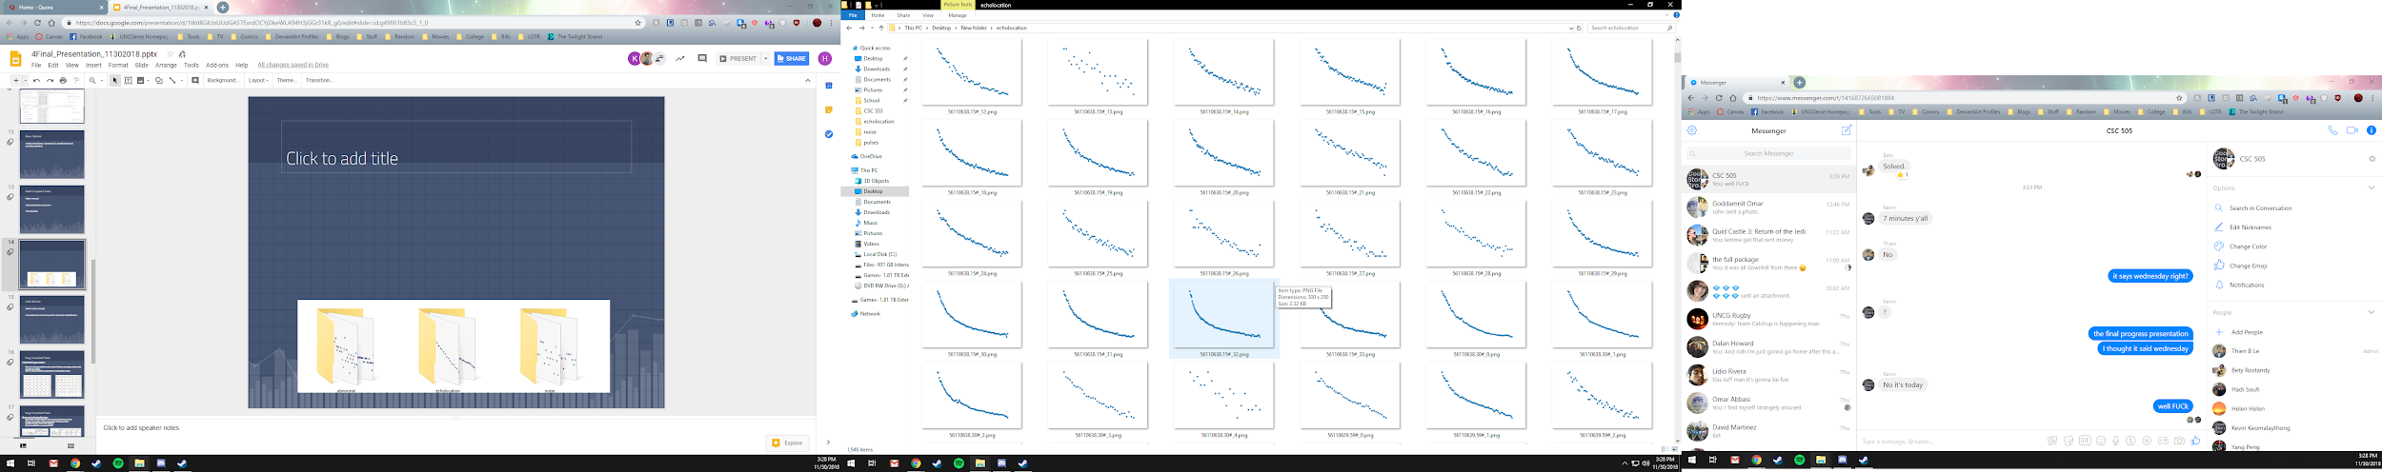
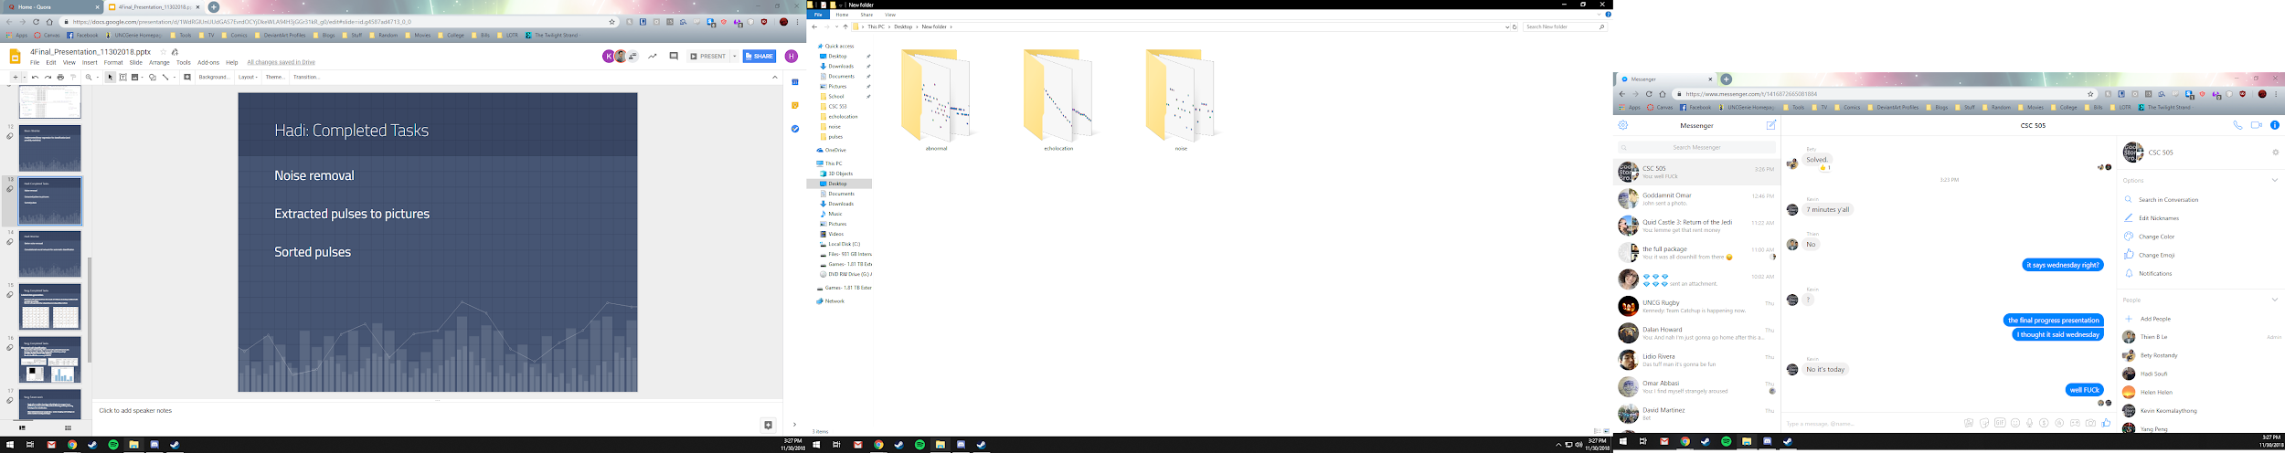
Pulse extraction to images

Slide 15
Hadi: Wishlist
Better noise removal
Convolutional neural network for automatic classification

Slide 16
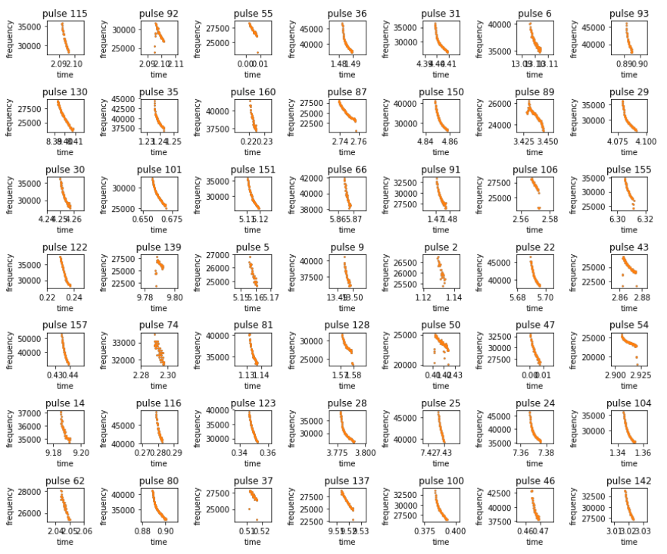
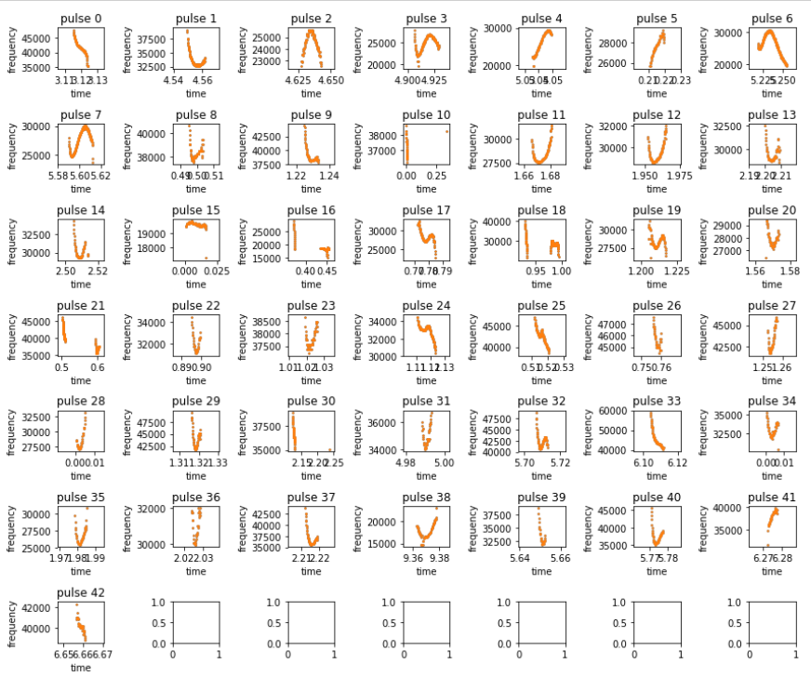
Yang: Completed Tasks
Labeled data generation:
Abnormal calls: generated from the result of K-Means clustering combined with specialist knowledge.
Normal calls: generated by using bulk processing utility method.
Notes:
We gained insight on which clusters contain mostly abnormal calls from the clustering results. We combined that with specialist knowledge to further manually label abnormal pulses. 204 sample observation: 161 from normal pulses and 43 from abnormal pulses (after noise removal)
2000 150
to differentiate the normal and abnormal pulses. We need to extract features for classification techniques to learn by itself.

Slide 17
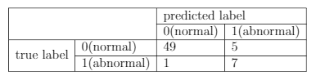
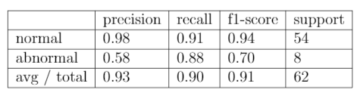
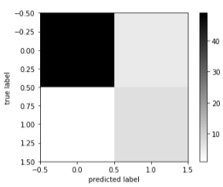
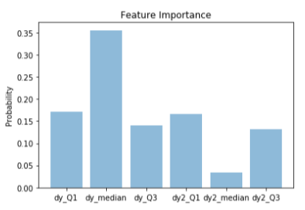
Yang: Completed Tasks
Abnormal call classification:
Observation: 204 including 161 normal calls and 43 abnormal calls
Feature: 1st quantile, median, 3rd quantile of both dy and dy2
Classifier: Random Forest with 100 trees
Result: classification accuracy is 90.32%
Notes:
experiment
7:3 training : testing

Slide 18
Yang: Wishlist
Apply other machine-learning methodologies to compare to our preliminary result, such as hierarchical clustering and deep learning techniques for classification.
More labeled abnormal samples (i.e. social, foraging and feeding) can aid in machine learning technique.

Slide 19
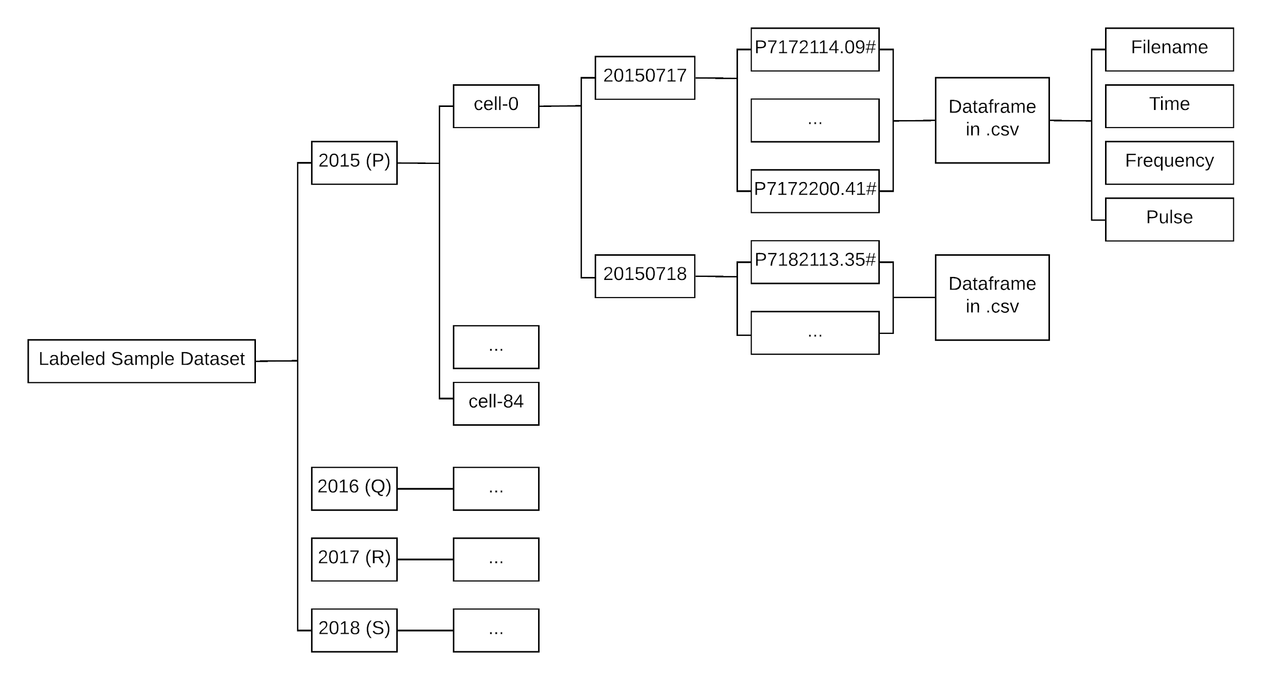
Bety’s Completed Task

Slide 20
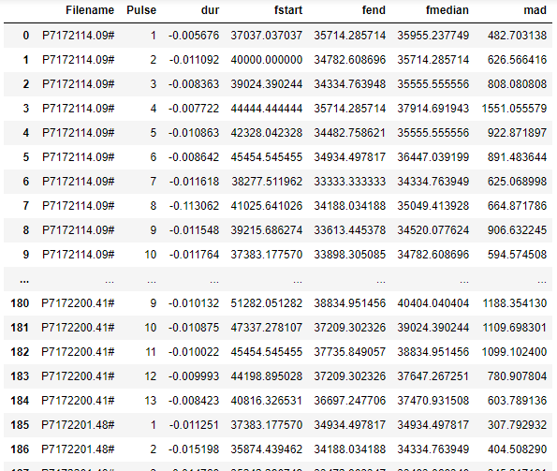
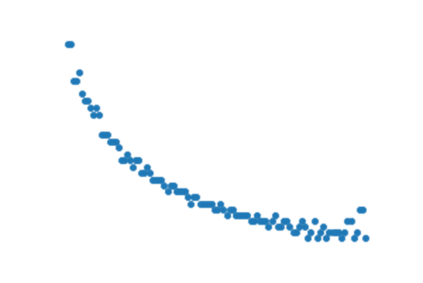
Bety’s Wishlist
P7172114.09#_1.png

Slide 21
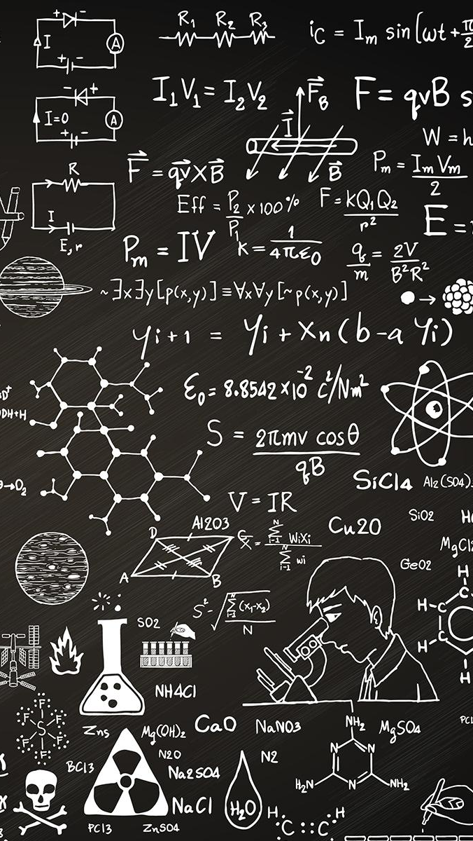
THANKS!
Any questions?

